Slide 1

Relationship Between
Trump's tweets and Stock Returns
PROJECT 5
Group members:
Elise Nguyen
Natalie Williams
Yue Liang
Luyao Sun

Slide 2
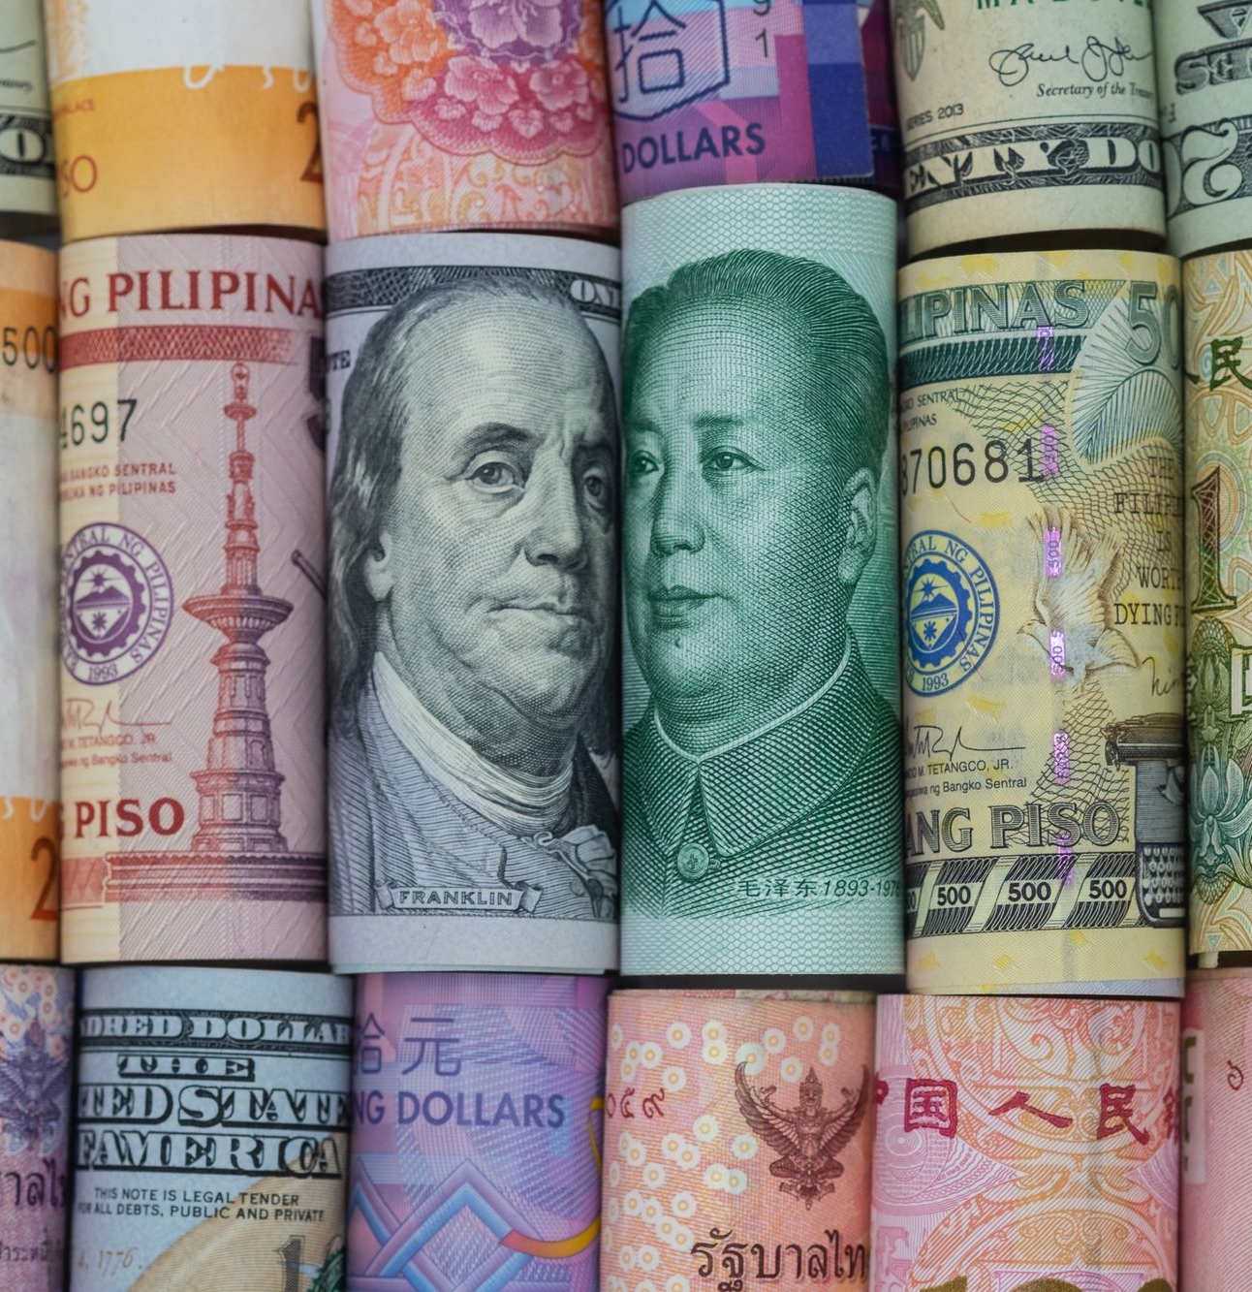
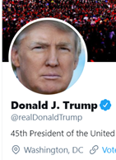
TWITTER
“ China has been taking advantage of the united states on trade for many years...there will be great and fast economic retaliation against china if our farmers ranchers and or industrial workers are targeted. ”
-- Donald Trump
September 18th, 2018

Slide 3

CONTENT
1
Natural Language Processing(NLP) Algorithms
3
Evaluation of NLP Algorithms
LSTM
Textblob
Conduct Manually Evaluation of the two NLP Algorithms
4
2
Indices/ ETFs Examined
Regression Results
S&P 500
FXI
SSE
Run the Linear Regression on the Financial Market and the Sentiment Analysis Result.

Slide 4

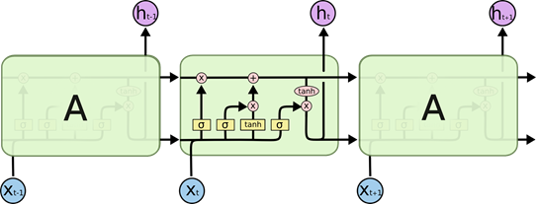
Natural Language Processing(NLP) Algorithms
Long Short Term Memory (LSTM) Model
Textblob Model
1990
2001
2007
2012
2020
Image Source: Christopher Olah, ‘Understanding LSTM Networks”
Rate the sentiment of tweets as a comparison to the LSTM Model
Returns probability of tweet being negative or positive
-1 -> negative tweet, +1-> positive tweet
Includes subjectivity as a result
Subjectivity: how much a statement is rooted in personal opinion or emotion rather than facts
Represents subjectivity as a float within [0,1]
Recurrent neural network
Differs from other neural networks: can process sequences of data as opposed to individual data points
Information learned from previous data is used as context for new data
Unique ability to de-emphasize or emphasize knowledge gained from past inputs

Slide 5

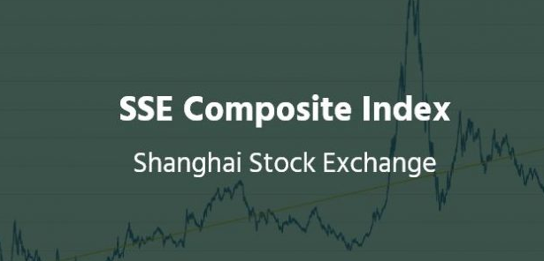
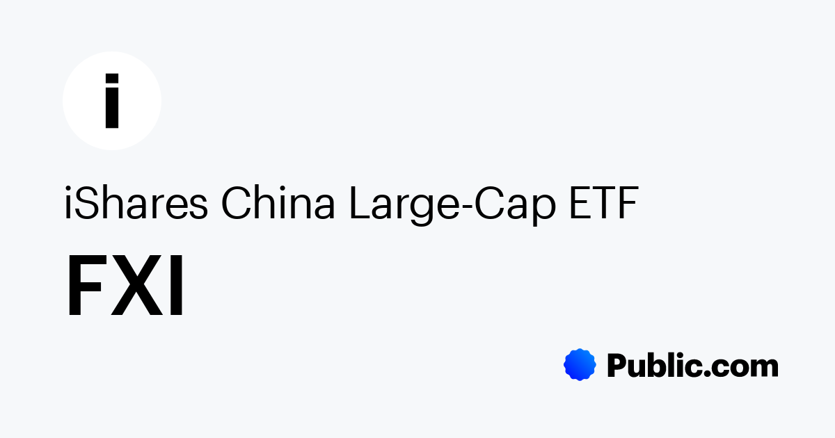
Indices & ETFs
S&P 500: index that measures the stock performance of 500 large companies listed on stock exchanges in the United States
Average annual return: 10% (6% after inflation)
Traded 9.30 a.m. to 4 p.m. EST
SSE: is a stock exchange based in the city of Shanghai, China. It is operating independently in mainland China.
Traded at the Shanghai Stock Exchange
Traded 9.30 a.m. to 4 p.m. GMT+8
FXI: track the investment results of the FTSE China 50 Index composed of large-capitalization Chinese equities.
International Investors Allowed
Traded on the Hong Kong Stock Exchange
Traded 9.30 a.m. to 4 p.m. EST
1990
2001
2007
2012
2020

Slide 6
Evaluation of NLP Algorithms
Two team members read through and manually categorized 100 tweets into positive (1), negative (-1), and neutral (0)
Compared to algorithms outcome:
Average % accuracy for LSTM: 46%
Average % accuracy for TextBlob: 59%
1990
2001
2007
2012
2020

Slide 7
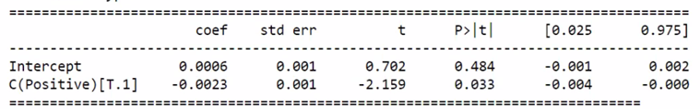
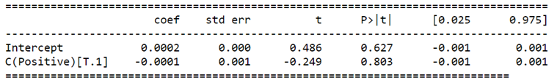
Linear Regression Results
Regressed Close-Open and Open-Close returns of S&P, SSE, FXI against LSTM and Textblob sentiment outcome
Calculated Point Biserial Correlation: equivalent to the Pearson correlation, used when one variable is dichotomous
Most significant result: SSE vs. Textblob: Close-Open
Compared to S&P vs. Textblob: Close-Open

Slide 8
Reasons for Low Correlation & Significance
Not Enough Details in Tweets on Trade Deal
Mixed Sentiments
Noise
1990
2001
2007
2012
2020
Trump tweets
don’t have details on trade deal
Hard for stocks movement to reflect the sentiment
Trump tweets may be ‘positive’ for United States, but negative about China/ other countries
Hard for NLP algorithms to categorize into + or - sentiments → not great accuracy
Trump tweets about topics unrelated to China/ Trade war

Slide 9

Ways to Improve
“ Apple prices may increase because of the massive tariffs we may be imposing on china… make your products in the united states [with a tax incentive] instead of china… ”
-- Donald Trump
September 8th, 2018
Improve NLP algorithms: take into account complex sentiment (positive to the US but negative to China for example)
Expand context to include news headlines or press conference releases, i.e. details of a new tariff deal may be published and markets fluctuate before Trump tweets about the deal
Experiment with different time window for regression
1990
2001
2007
2012
2020

Slide 10
References
Yuan, K., Liu, G., Wu, J., & Xiong, H. (2020). Dancing with Trump in the Stock Market: A Deep Information Echoing Model. ACM Transactions on Intelligent Systems and Technology (TIST), 11(5), 1-22.
Bhoi, A., Pujari, S. P., & Balabantaray, R. C. (2020). A deep learning-based social media text analysis framework for disaster resource management. Social Network Analysis and Mining, 10(1), 1-14.
Quantilia (2018) The trade war effect on commodities https://www.quantilia.com/the-trade-war-effect-on-commodities-2/
https://medium.com/@outside2SDs/an-overview-of-correlation-measures-between-categorical-and-continuous-variables-4c7f85610365
https://en.wikipedia.org/wiki/Point-biserial_correlation_coefficient
https://topforeignstocks.com/foreign-adrs-list/the-full-list-of-chinese-adrs/

Slide 11
Project 5
Presentation
Thank You
Group members:
Elise Nguyen
Natalie Williams
Yue Liang
Luyao Sun

